Slide 1


Centre for Digital Public Infrastructure
IDs - functional & foundational
DPI Building Block in Focus

Slide 2

Thailand
In under two years, ThaiID reduced the share of population uninsured by healthcare from 29% to under 5%
Launched in 2019, used to guarantee subsidized health care to all citizens
Source: Wilson et al, 2021
Notes:
También garantiza que los individuos sean automáticamente trasladados de una parte de los registros de seguros a otra cuando los cambios en su estado laboral cambian la forma en que están cubiertos.

Slide 3
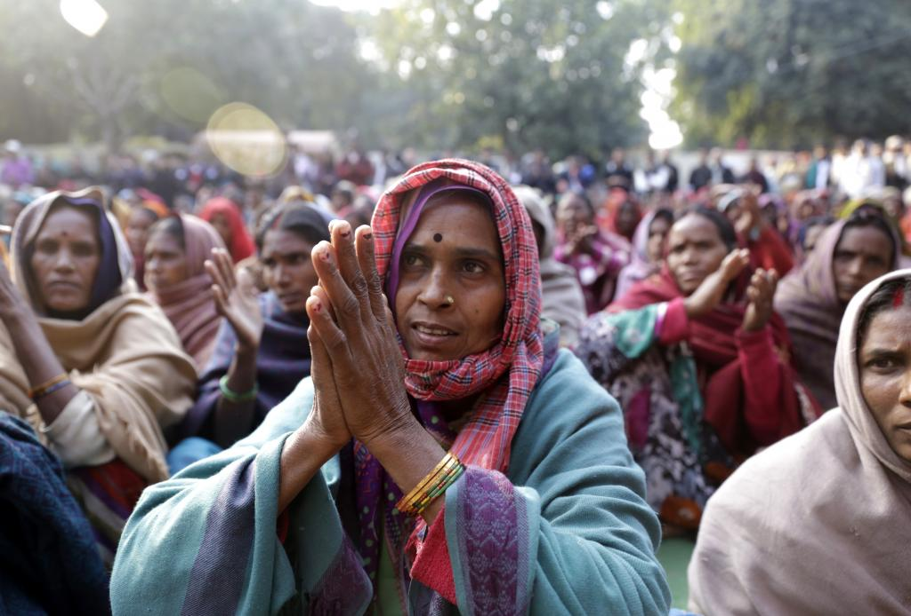


As of 2008, India was one of the world’s
most unbanked
Less than 20% banking penetration

Slide 4
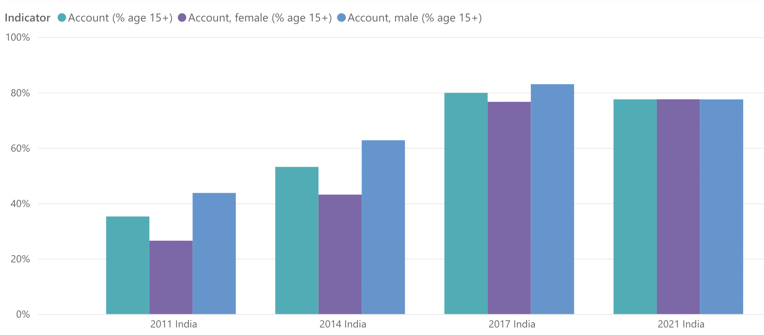


In 9 years, India’s banking penetration shot up from
<35% to ~80% using a digital ID, closing the gender gap!
80%
83%
78%
78%
78%
77%
63%
53%
44%
43%
35%
27%
Sources: World Bank Findex Data 2011-2021: https://www.worldbank.org/en/publication/globalfindex/Data
Notes:
Se han abierto 462 millones de cuentas, el BIS estimó que esto habría tomado 50 años. El 56 por ciento pertenece a mujeres y el 67 por ciento está en áreas rurales y semiurbanas. Son 47 años y 9 años para ser precisos. Era menos del 10% en 2008, 80% en 2017.

Slide 5

Countries do not need to create brand new ID systems
Can build on many existing ID systems…
Existing ID
database
Auth/eKYC
modules
…By adding
auth & eKYC!

Slide 6

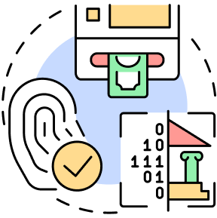

Capabilities of a Digital ID
Authentication:
Returns Y/N to the question “Are you who you claim to be?”
eKYC:
Authentication + Profile Information Sharing
Avoids recollecting data across services

Slide 7


The only way to keep an ID system accurate is ensure that it’s used regularly!
ID auth & eKYC increases
Usage of ID system for services
Driving increased coverage
and ensuring that data is kept up-to-date

Slide 8






India’s Digital ID Infrastructure
For Private & Public innovation
860 M
ID linked bank accounts
90%+
Mobile density
470 Mn opened in 8 yrs!
102 Bn
ID AUTHENTICATIONS
16 Bn
e-KYC TRANSACTIONS
AADHAAR
Unique digital identity
1+ Bn auths / month
Random 12 digit number
Only 4 mandatory data fields
+ biometrics
1.38 Billion
Unique ID Numbers Issued
Source: https://uidai.gov.in/
‹#›
Content of this deck is licensed under CC BY-SA 4.0
‹#›

